Slide 1
IT Outsourcing
Marcus Goncalves
Boston University – MET
Fall 2005
CS782

Slide 2



The Challenges
Globalization and technical development will make management more complex
Competition and pace of changes will increase
  Object technology is key to integration and flexibility
Superior customer responsiveness
  Customer responsiveness, service and cost are the key metrics in eBusiness
  Make to order capabilities (more customers, smaller orders, special grades due to Internet and eCommerce)
Concentration on core business will be necessary
  concentrate on core business and find the best-in-class partners
Instant access to the latest information for decisions (Enterprise integration)

Slide 3



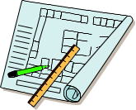



MetalsFrame
Core Business Processes
The Core Business Processes
End Customer
Order
Generation
Order
Fulfillment
Customer
Service
Product
development
ABB's Customer
Order
Generation
Order
Fulfillment
Customer
Service
Product
development
Order
Generation
Order
Fulfillment
Customer
Service
Product
development
Notes:
The MetalsFrame concept starts with the supply chain, including ABB, ABB's customer, and the customer's customer
<advance>
We are focusing on the order fulfillment process of ABB's customer

Slide 4
Seamless integration….
How is the
Enterprise Resource
business
Planning
Customers
running?
ERP
Management
production
Operations
schedule,
Production
maintenance
Sales
status,
Inventory,
Maintenance
cost factors
Quality,
Technical
Production status,
Quality
Downtime statistics
How is the
Manufacturing Execution
System
MES
laboratory
plant
manual
running?
entries
How is the
Set-points
Plant Floor Data
process
running?
Open Control Systems - OCS

Slide 5

Enabling Order Fulfillment Strategies
Customers
Customers
Demand
Purchasing
Order fulfilment
Enterprise Resource Planning
Right quantity
Right quality
Right time
Right cost
Prod. Mgt
Shipping
Production
Scheduling & Tracking
Integrated Plant Systems
Steel making processes

Slide 6
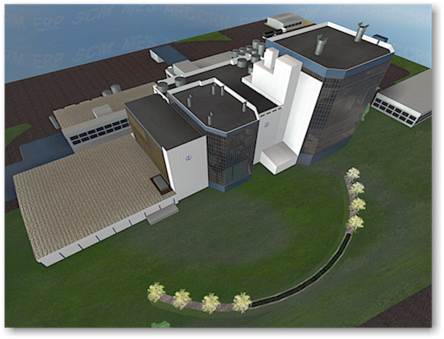

Current Systems
Monthly Event:
Translation of Day-to-Day Production Actions & Results
into Performance Reports
Monthly
ERP/ERM
SCM
General
Ledger
Sites
Realtime Domain
Monthly
Transactional Domain

Slide 7

Industrial IT (Outsourcing)
Industrial IT
Automated, Real-time Translation Between Action, Reporting Domains
Action Domain (Production) Reporting Domain (Accounting)
Daily
Periodic
ERP/ERM
Realtime
SCM
General
Ledger
Realtime Domain
Periodic
Transactional Domain

Slide 8
Imagine ..
Imagine a business enterprise where plant automation, asset optimization, and decision support strategies are seamlessly linked in real time . . .
CRM
ERP
MES
IPS
(MES/OCS)
OCS

Slide 9

The Connected Economy
Connectivity of
Customers, Suppliers, Competitors,
Products
Alliances and Partnership
The
Connected Economy
Brands, Knowledge/Skills
Speed - The “Velocity of Business”
Real-time
24 hours per day/365 days per year
From Products to “Solutions”

Slide 10



Customer Perspective
…..eCommerce Market Evolution
Supply-Chain
Integration
Online
Payments
‘02/2005
Web Storefront
Interactive
Marketing
Web
Presence
‘99/’01
‘96/’98
Notes:
Information is a
valuable resource
It can add to the value
perceived by Your customer - make it available !

Slide 11
Ebusiness extends the Real-time
Web user interface applications
CompanyMgmt.
Internet/Web
ERP systems
Supplier
Customer
MES/OCS systems
Value Chain

Slide 12
Evolving Process Industry Operating Model
Real-time MES
High-Velocity
CRM/SCM
Customer
Internet Portal
eCommerce
High-Velocity
CRM/SCM
NZDG
Real-time MES

Slide 13
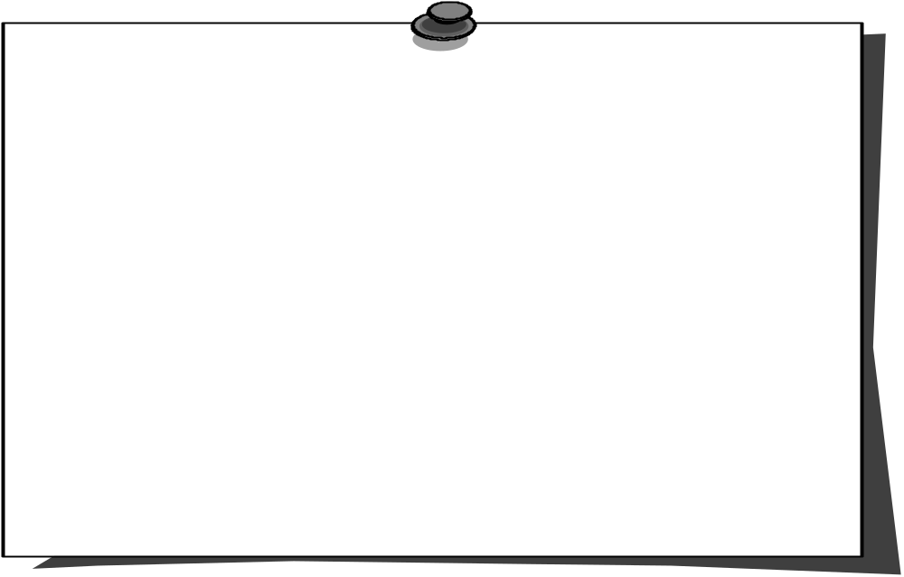
IT Outsourcing Five R's Principle
  Relevant Information
    At the Right Time
    At the Right Place
    In the Right Form
    To the Right People
Relevant information is not only the most sought-after resource in business
today, it’s an absolute necessity for survival.

Slide 14
Integrated Plant Systems
ERP
ERP/CRM/SCM
MES
OCS
Order
Tracking
Integrated
Plant
Systems
Planning
Shipping
MES
OCS
SENSORS
ACTUATORS
Real-time Connectivity
Notes:
The next 3 slides introduce the concept of ERP/MES/OCS (Definition by
Gartner Group)
This first slide only gives an overview of the "traditional" 3 levels of
ERP/MES/OCS. The following 2 slides discuss the systems from a functional
point of view.
Message:
ABB can supply all of these types of systems, our own and from
partners (ERP)

Slide 15
The Improvement Loop
Measurement
(Data Acquisition)
Understanding
(Analyse Data and come
to a conclusion)
Control
(Action)
Process Equipment
if you can't measure it, you can't understand it
if you can't understand it, you can't control it
if you can't control it, you can't improve it
Notes:
Information is a
valuable resource
It can add to the value
perceived by Your customer - make it available !

Slide 16
The Broader Improvement Loop
Measurement
(Equipment Status)
Understanding
(Analyse Data and reschedule
orders and production)
Control
(Action-Production changes)
Process Equipment
if you can't measure it, you can't understand it
if you can't understand it, you can't control it
if you can't control it, you can't improve it
Notes:
Information is a
valuable resource
It can add to the value
perceived by Your customer - make it available !

Slide 17
The challenge….
"We have an immense amount to do in graphics, in video, and in bringing a unified object approach to browsing and storing data. It´s a deep problem in computer science. A deep, deep problem. We have too many stores of data today. We have file systems, message systems, directory systems, database systems and all sorts of different software that optimizes all those things. That is not going to cut it…
...Users are going to need one integrated thing that hides all those differences."
-- Bill Gates 1997 (Giants, ISBN 0-07-032934-6)

Slide 18
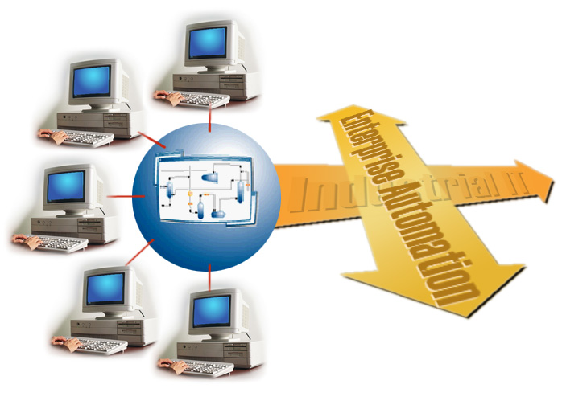
Industrial IT Platform for Enterprise Automation
Enterprise
Planning
Production
Planning
Asset
Optimization
Process
Optimization
Process
Automation

Slide 19
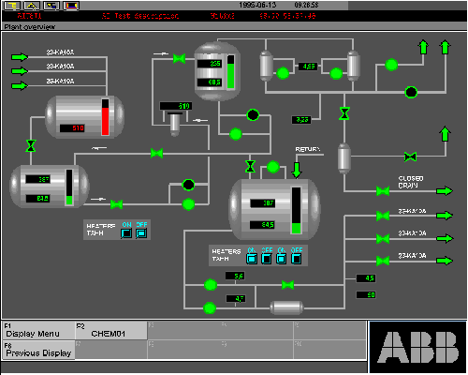
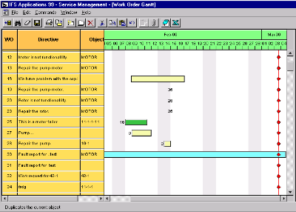
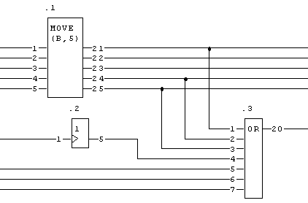
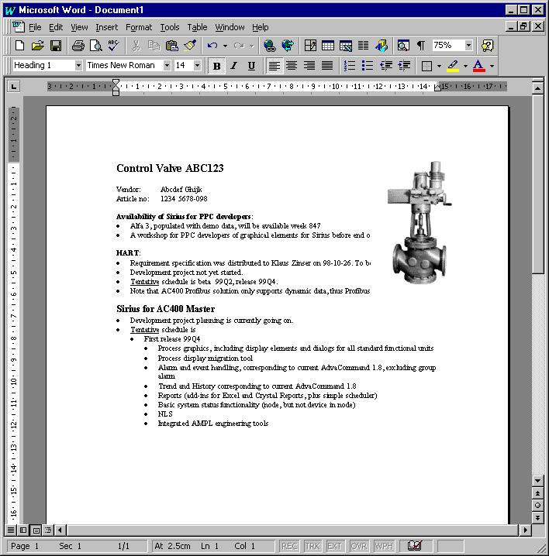
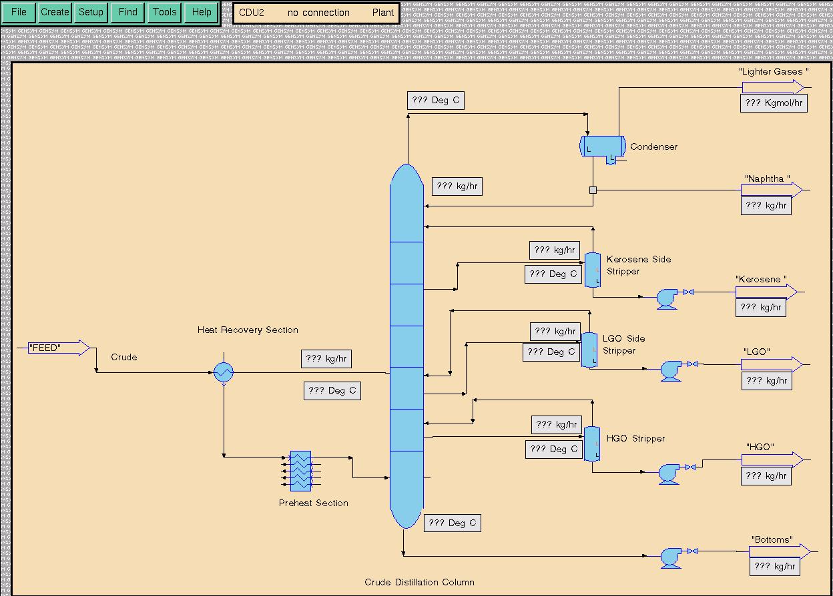
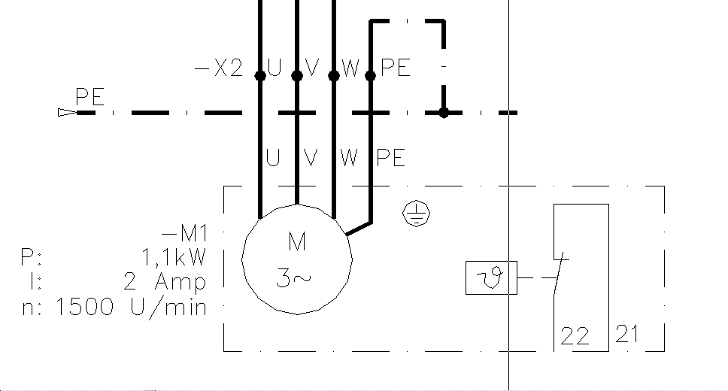
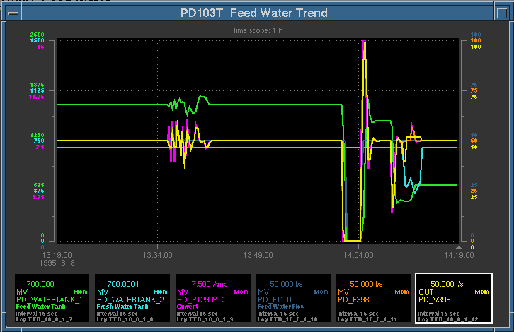
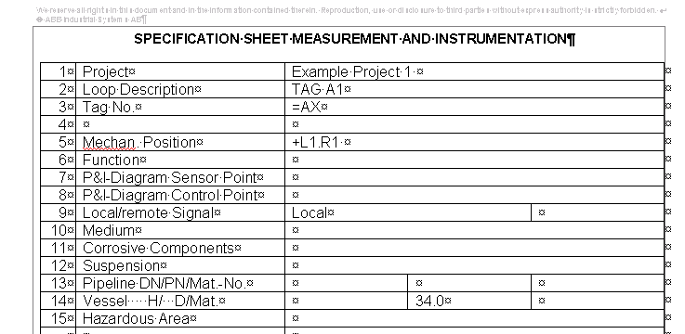
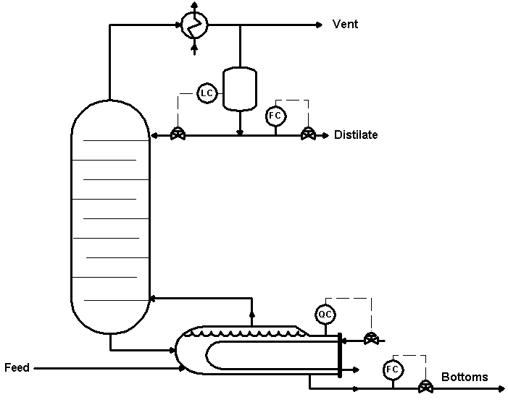
Objects and Aspects
Integrate the Enterprise
Aspects
Human-System Interface
ERP system
Real
Object
Model
Object
Operator Interaction
Production status
Operator interaction
Control
Control builder
MS Word
Control
Data sheet
Simulation Model
Simulator
Electrical CAD
Simulation Model
Electrical diagram
CAD system
MS Excel
P&I Diagram
Integrated
Independent
SW Systems
P&I Diagram
Loop spec
Notes:
We have the solution!
<advance>
We do not create one single data model, or object model, to represent the real world object in our system
<advance>
Instead we model one aspect at a time
Thus, the model object is not an object in a strict sense, but rather a container of references to different objects that implement the aspects
<advance>
The aspects are implemented by different software systems (aspect systems), each of which stores, manages and presents its information in its own optimal way
<advance>
The result is a system of integrated but independent software systems ...
<advance>
… and it's open, so that new software systems, that were not even anticipated from start, can be added without impacting the ones that are already in place

Slide 20
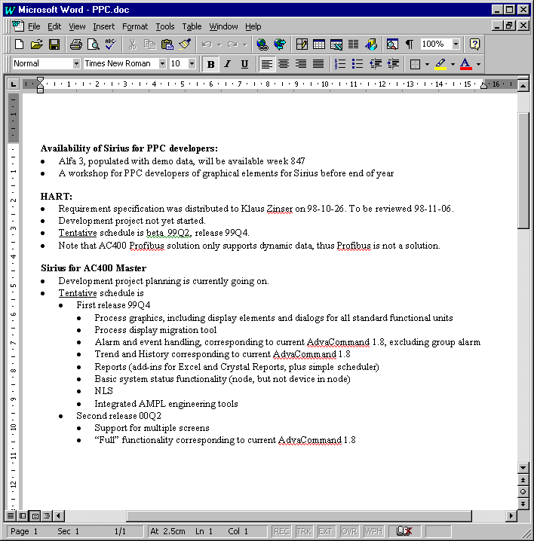
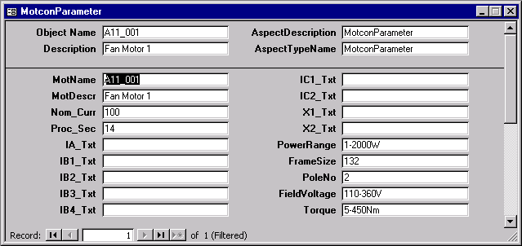
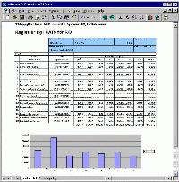
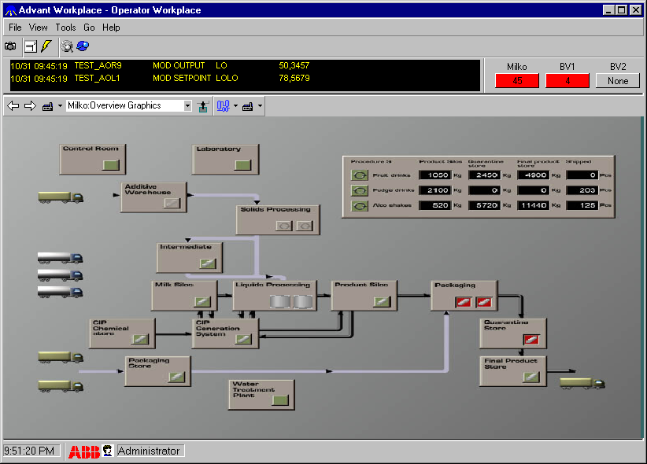
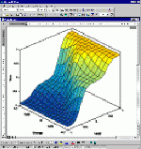
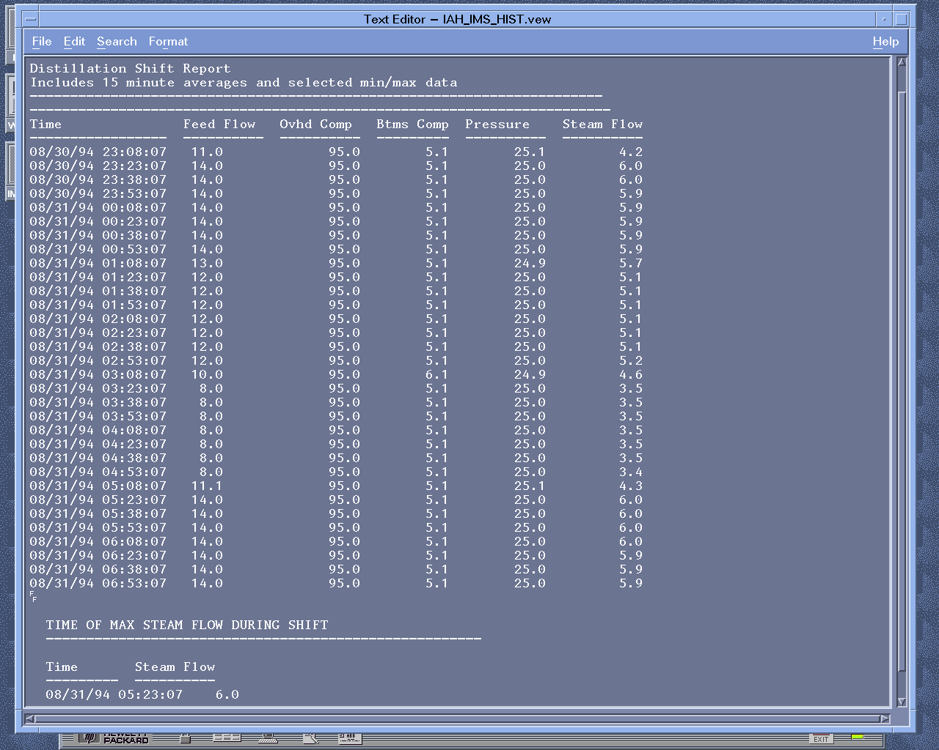
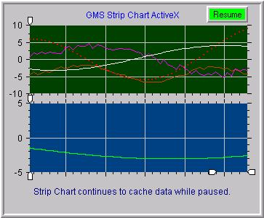
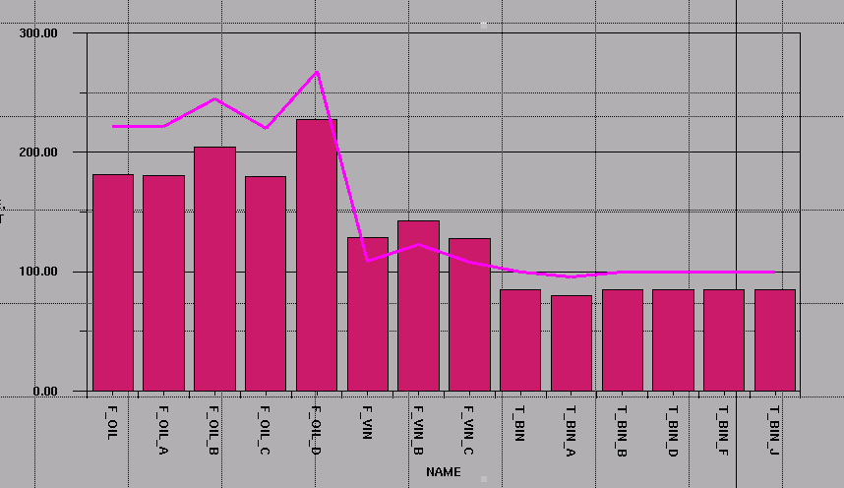
Industrial IT - Integrate Aspects of Plant and Process Entities
Production order
Product
specification
Production
schedule
Operator
interaction
Stock
report
Quality
report
Production
report
Profile
data
Notes:
In the enterprise we deal with many objects of different kinds. It can be physical process objects, like the valve in the example, or products, material, production orders, batches, ...
Each object can be described from several different aspects
Each aspect defines a piece of information, and a set of functions to create, access, and manipulate this information.
We want to implement these functions using many different applications, existing and new ones, from ABB, third parties and customers, now and in the future
We want to be able to do this without major changes to these applications.
We can not expect all applications even to be aware of each other
Still we want them to cooperate to provide an integrated view of the object
We need "one integrated thing that hides all the differences"

Slide 21
MGCG Unified Enterprise Model
Unified IT Outsource Enterprise Model
Completion
Enterprise Systems
Plan
Supply
Optimize
Control
Distribution
Automation Systems
Concept

Slide 22
Imagine ..
Q&A

